Slide 1
Factory-Built Housing in Canada – Evolution, Regulatory Requirements and Confirmation of Compliance
Module 6: Confirming Compliance
Prepared for Municipal Officials in British Columbia August 2017

Slide 2
Modules
Who We Are – CHBA-MOD and MHABC
Factory-Built Housing - Then and Now
The Industry
Applicable Technical Requirements
Facilitating Compliance
Confirming Compliance
Challenges
Take-Aways
6 -
Notes:
Module 6 – Confirming Compliance
With the exception of manufactured homes that comply with the CSA Z240 MH Series of standards, prefabricated buildings, like site-constructed buildings, must comply with the BC Building Code.
This Module explains how the compliance of prefabricated buildings can be confirmed by the local authority.

Slide 3
Confirming Compliance
Subjects
Certification as a means of confirming compliance
Certification standard for prefabricated buildings, modules and panels
Administrative provisions in the building code
Certification procedure for prefabricated buildings, modules and panels
On-site inspection of prefabricated buildings to confirm compliance
What to do if non-compliance is identified
6 -
Notes:
Module 6 – Confirming Compliance
Subjects
Five topics are discussed:
certification as a means of confirming compliance
the certification standard for prefabricated buildings, modules and panels
administrative provisions in the building code
the certification procedure for prefabricated buildings, modules and panels
on-site inspection of prefabricated buildings that the industry expects local authorities to carry out to confirm compliance, and
what to do if non-compliance is identified

Slide 4
Confirming Compliance
Certification
Products accepted based on certification:
lumber
electrical fixtures, wiring, fittings
plumbing fixtures, piping, fittings
gas- and oil-fired appliances, piping, fittings
windows, doors, skylights
etc.
Certification is recognized by the National Building Code as means for accepting buildings and components
6 -
Notes:
Module 6 – Confirming Compliance - Certification
Certification
Certification has been and continues to be an essential tool for confirming compliance of many building components where the required level of performance cannot be confirmed by simple visual inspection.
Reliance on certification as a means for accepting buildings and components has been recognized for decades and is discussed in some detail in the Preface to the National Building Code.
In BC, the local authority need not accept products based on certification. While it may be within their purview to reject certified products, second-guessing certification without significant evidence of a problem would lead to a serious breakdown of the regulatory process.
If a problem is identified with any certified product, the certification agency should be contacted to address the issue.

Slide 5
Confirming Compliance
Certification Bodies
accredited by the Standards Council of Canada
develop certification procedures
in-plant quality process
identification of personnel and responsibilities
sign-offs
record-keeping
product certification marking
annual audits by the certification body
random inspections by the certification body
6 -
Notes:
Module 6 – Confirming Compliance - Certification
Certification Bodies
Certification bodies in Canada are accredited by the Standards Council of Canada.
They develop certification procedures that address
the in-plant quality process including - identification of personnel and their responsibilities - sign-offs at every stage of the process - record-keeping, and - certification marking
annual audits by the certification body
random inspections by the certification body

Slide 6
Confirming Compliance
Certification Standards
Standards addressing certification are administrative
not typically referenced in the NBC or provincial-territorial building codes or regulations
rare exceptions in body of NBC and BCBC
4.3.4.3.(1) CAN/CSA-A660, “Certification of Manufacturers of Steel Building Systems.”
9.21.2.1.(3) certification of solid-fuel-burning appliance for connection to a chimney flue serving an oil-burning appliance
6 -
Notes:
Module 6 – Confirming Compliance - Certification
Certification Standards
Standards and other requirements that address responsibilities and “who does what” are administrative.
These are kept to a minimum in the NBC, leaving the provinces and territories to develop their own administrative provisions
Certification requirements in building codes and regulations are very rare because:
standards don’t exist for many products
where they exist, if referenced at all, they are typically provided in the related material and component standards.

Slide 7
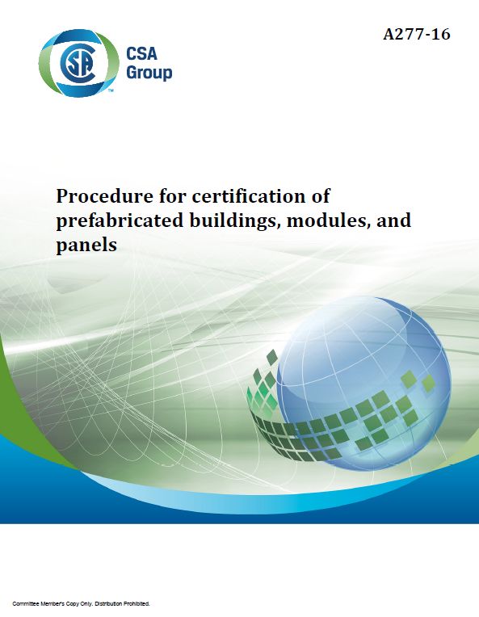
Confirming Compliance
CSA A277 Procedure for Certification of Prefabricated Buildings, Modules and Panels
developed for consistency of certification processes among certification bodies
same basic process as for any product
larger scale
more checks and sign-offs
6 -
Notes:
Module 6 – Confirming Compliance – CSA A277
CSA A277 Procedure for Certification of Buildings, Modules and Panels was developed to provide consistency in certification procedures for these products.
Certification of a complete building, or buildings modules or panels, follows the same as process as certification of any product – simply on a larger scale with more checks and sign-offs.

Slide 8
Confirming Compliance
CSA A277 Procedure for Certification of Prefabricated Buildings, Modules and Panels
Referencing in building codes and regulations
National Building Code
Division A Appendix Note explaining the role of CSA A277
provincial-territorial building codes or regulations
Division A, Appendix Note, except in BC
in some cases, referenced in the body of the code
6 -
Notes:
Module 6 – Confirming Compliance – CSA A277
Referencing in Codes and Regulations
Because CSA A277 is administrative, it is not referenced in the National Building Code except in an Appendix note that explains the role of the standard.
All provincial and territorial building codes or regulations, except the BC Building Code, have the same or a similar Division A Appendix note.
Some provinces and territories reference CSA A277 in the body of their codes or regulations.

Slide 9
Confirming Compliance
CSA A277 Procedure for Certification of Prefabricated Buildings, Modules and Panels
Referencing in building codes and regulations
CSA A277 certification is required in Alberta and Quebec for all prefabricated building
CSA A277-certified buildings are accepted
by reference in building codes or regulations in Yukon, Ontario*, Nova Scotia*
by local authorities in most other jurisdictions, by policy or practice
* Residential only
6 -
Notes:
Module 6 – Confirming Compliance – CSA A277
Referencing in Codes and Regulations
CSA A277 certification is required in Alberta and Quebec for all prefabricated building
CSA A277-certified buildings are accepted
by reference in building codes or regulations in Yukon, Ontario*, Nova Scotia*
local authorities In most other jurisdictions, by policy or practice

Slide 10
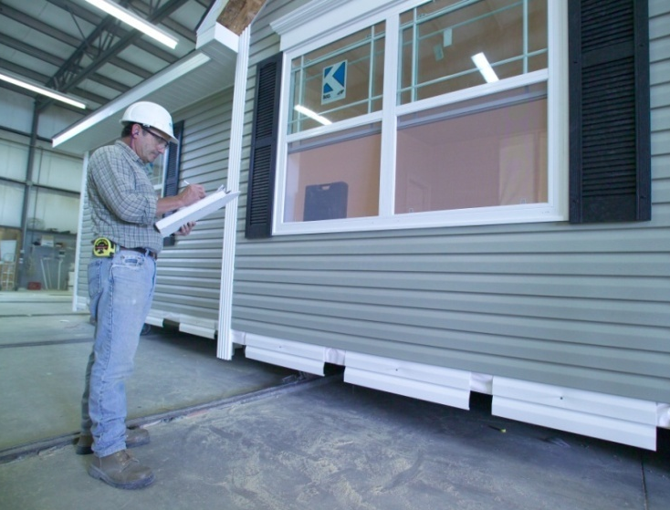
Confirming Compliance
CSA A277 Procedure for Certification of Prefabricated Buildings, Modules and Panels
CSA A277 certification may be relied on, whether the standard is referenced or not, the same as any other product certification.
6 -
Notes:
Module 6 – Confirming Compliance – CSA A277
Referencing in Codes and Regulations
What is important is to recognize that
CSA A277 certification may be relied on, whether the standard is referenced or not, the same as any other product certification
The certification procedure is discussed in detail after a review of the administrative provisions in the Building Code

Slide 11
Confirming Compliance
BCBC Division C Administrative Provisions
2.2.7. Professional Design and Review
6 -
Notes:
Module 6 – Confirming Compliance – Administrative Provisions
BCBC Administrative Provisions
In Division C Administrative Requirements we find provisions that address issues such as:
the information that must be provided to demonstrate that proposed work will comply with the Code
and design and construction review.

Slide 12
Confirming Compliance
BCBC Division C Administrative Provisions
2.2.7. Professional Design and Review
2.2.7.1. Application
Part 3 buildings
Part 9 buildings with shared egress and required firewalls
structural elements of Part 9 buildings designed to Part 4
sprinkler and stand-pipe systems2.2.7.5. Off-Site Review
6 -
Notes:
Module 6 – Confirming Compliance – Administrative Provisions
BCBC Administrative Provisions
The BC Building Code includes requirements defining the responsibilities of building owners and registered professionals with respect to:
Part 3 buildings
Part 9 buildings with shared egress and required firewalls
structural elements of Part 9 buildings where the elements are designed to Part 4
sprinkler and stand-pipe systems
The assurances provided by registered professionals are comparable to certification.
The difference is that a certification body rather than an individual takes responsibility for assuring compliance.

Slide 13
Confirming Compliance
NBC Division C Administrative Provisions
2.2.7. Review of Work
2.2.7.1. Application
Subsection applies to Part 4 buildings except Article 2.2.7.5. applies to all buildings
2.2.7.5. Off-Site Review
1) Where a building or component of a building is assembled off the building site in such a manner that it cannot be reviewed on site, off-site reviews shall be provided to determine compliance with this Code.
6 -
Notes:
Module 6 – Confirming Compliance – Administrative Provisions
NBC Administrative Provisions
As mentioned, administrative requirements in the National Building Code are purposely limited but there are some requirements.
Division C, Subsection 2.2.7. in the NBC principally applies to structural design of buildings to which Part 4 applies, but the final Article applies to all buildings.
Article 2.2.7.5. states that
for any building or component of a building that is assembled off site
and
where compliance cannot be confirmed with a simple visual inspection,
documentation of off-site review must be provided.

Slide 14
Confirming Compliance
NBC Division C Administrative Provisions
2.2.7. Review of Work
2.2.7.1. Application
Subsection applies to Part 4 buildings except Article 2.2.7.5. applies to all buildings
2.2.7.5. Off-Site Review
1) Where a building or component of a building is assembled off the building site in such a manner that it cannot be reviewed on site, off-site reviews shall be provided to determine compliance with this Code.
= certification
6 -
Notes:
Module 6 – Confirming Compliance – Administrative Provisions
NBC Administrative Provisions
Certification fulfills this requirement.
Article 2.2.7.5. is “reserved” in the BCBC. It might be worth adding the NBC provision.

Slide 15
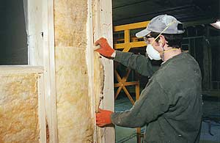
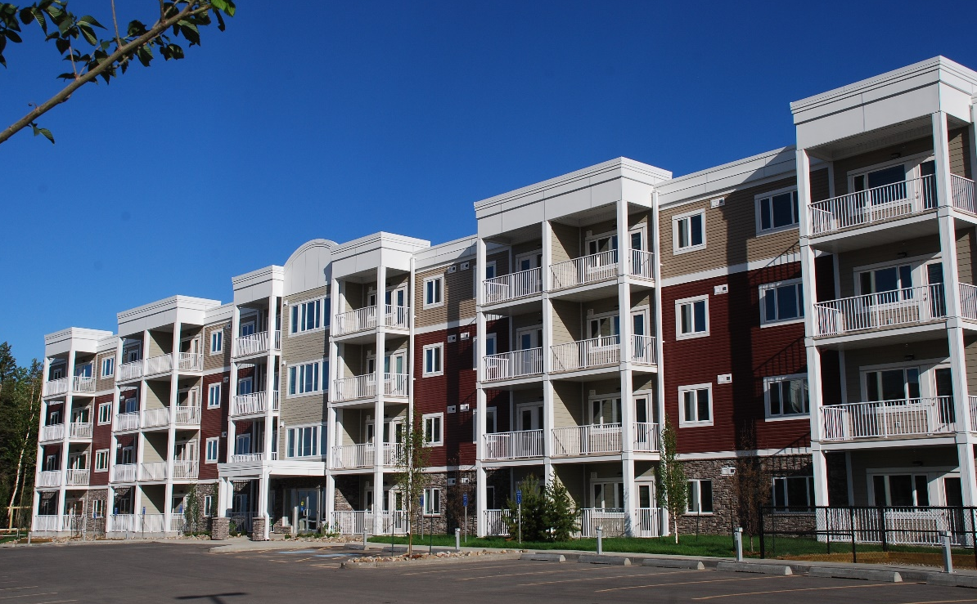
Confirming Compliance
CSA A277 Certification Procedure
Process
Product
Guildcrest Homes, ON
6 -
Notes:
Module 6 – Confirming Compliance - Certification
Certification Procedure
Like any certification procedure, CSA A277 requires that there be an in-plant quality process that addresses both:
the process
and the product

Slide 16
Confirming Compliance
CSA A277 Certification Procedure
In-plant quality program addresses
equipment
procedures
personnel
protection of materials and built products
6 -
Notes:
Module 6 – Confirming Compliance - Certification
Certification Procedure
Certification of the process addresses:
equipment
procedures
personnel qualifications and responsibilities
protection of materials and built products

Slide 17
Confirming Compliance
CSA A277 Certification Procedure
In-plant quality program manual includes
the organizational chart
descriptions of
procedures for document initiation and control
purchasing procedures
inspection procedures for in-house inspectors
description of the records retention system
procedure for disposition of non-conforming items
copies of forms for all checks and tests, and instructions for use
6 -
Notes:
Module 6 – Confirming Compliance - Certification
Certification Procedure
A quality program manual must be compiled and kept up to date.
It includes:
the organizational chart
descriptions of
procedures for document initiation and control
purchasing procedures
inspection procedures for in-house inspectors
description of the records retention system
procedure for disposition of non-conforming items
copies of forms for all checks and tests, and instructions for use
The last parallels procedures that building officials have for addressing non-compliances in site-constructed buildings.

Slide 18
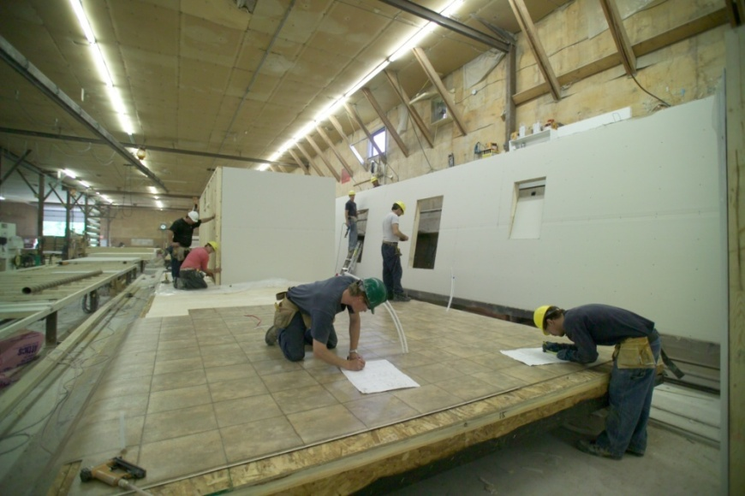
Confirming Compliance
CSA A277 Certification Procedure
In-plant quality program includes
sign-offs at every step
professional involvement as required by the applicable regulations
6 -
Notes:
Module 6 – Confirming Compliance - Certification
Certification Procedure
Checks of compliance are made at every step and forms must be completed and signed off, something that is certainly not done with site-constructed buildings.
Just as the buildings must comply with all the applicable technical requirements, design and construction review must comply with all applicable regulations.
Where professional involvement is required for site-constructed buildings, CSA A277 requires their involvement for prefabricated buildings in addition to the audits and inspections of the certification body.
Where buildings are larger or more complex, CSA A277 recommends that reviews by persons licensed in the jurisdiction where the product is to be installed may be appropriate, even where this is not required by local regulation.

Slide 19
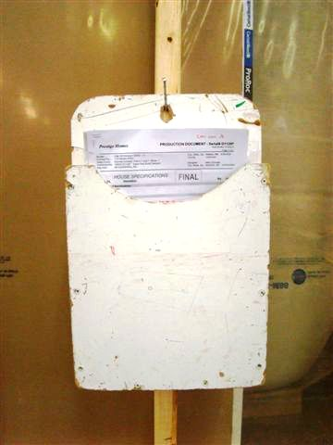
Confirming Compliance
CSA A277 Certification Procedure
In-plant quality program requires
a sign-off record that is kept
with the building until the end of the process
retention of the sign-off record and all drawings and specifications for a minimum 5 years
(actually retained at least until the end of the product warranty period)
6 -
Notes:
Module 6 – Confirming Compliance - Certification
Certification Procedure
The record with all the sign-offs is kept
with building until it is completed and
then filed with the drawings and specifications.
The sign-off record and all other building documents are required to be retained for a minimum of five years but are in fact retained at least until the end of the manufacturer’s warranty period and the mandated warranty period.
If a non-compliance is discovered, it is possible to identify the person responsible for that step in the design or construction process and address it at the source.
Because personnel stay with the company, the same issues don’t crop up over and over as they might if workers cycled in and out.

Slide 20
Confirming Compliance
CSA A277 Certification Procedure
In-plant quality program requires
a sign-off record that is kept
with the building until the end of the process
retention of the sign-off record and all drawings and specifications for a minimum 5 years
(actually retained at least until the end of the product warranty period)
6 -
Notes:
Module 6 – Confirming Compliance - Certification
Certification Procedure
The record with all the sign-offs is kept
with building until it is completed and
then filed with the drawings and specifications.
The sign-off record and all other building documents are required to be retained for a minimum of five years but are in fact retained at least until the end of the manufacturer’s warranty period and the mandated warranty period.
If a non-compliance is discovered, it is possible to identify the person responsible for that step in the design or construction process and address it at the source.
Because personnel stay with the company, the same issues don’t crop up over and over as they might if workers cycled in and out.

Slide 21
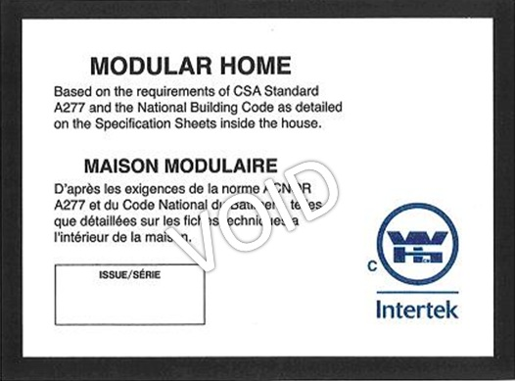
Confirming Compliance
How to Confirm Compliance
Labels or stamps
6 -
Notes:
Module 6 – Confirming Compliance
How to -
Confirming compliance of an A277-certified building, module or panel is not difficult.
There are two things the local authority should check when a building, module or panel is delivered to an installation site.
The first is the certification label.
Every building and module must have a label from one of the certification bodies that are accredited by the Standards Council of Canada.
Stamps may be used for panels.
The label will identify the certification body and the building code or standard to which the building complies.
The labels shown are from three of the four certification bodies accredited at the time this material was prepared.
The fourth is T.R. Arnold.

Slide 22
Confirming Compliance
How to Confirm Compliance
Labels
6 -
Notes:
Module 6 – Confirming Compliance
How to -
For example, this Quality Auditing Institute (QAI) label states that the building is certified according to CSA A277 as complying with the National Building Code

Slide 23
Confirming Compliance
How to Confirm Compliance
Labels
6 -
Notes:
Module 6 – Confirming Compliance
How to -
This CSA label states that the building is certified as complying with CSA Z240 MH Series Manufactured Homes.
While not identified, the CSA A277 procedure is also used for certification of manufactured homes.

Slide 24
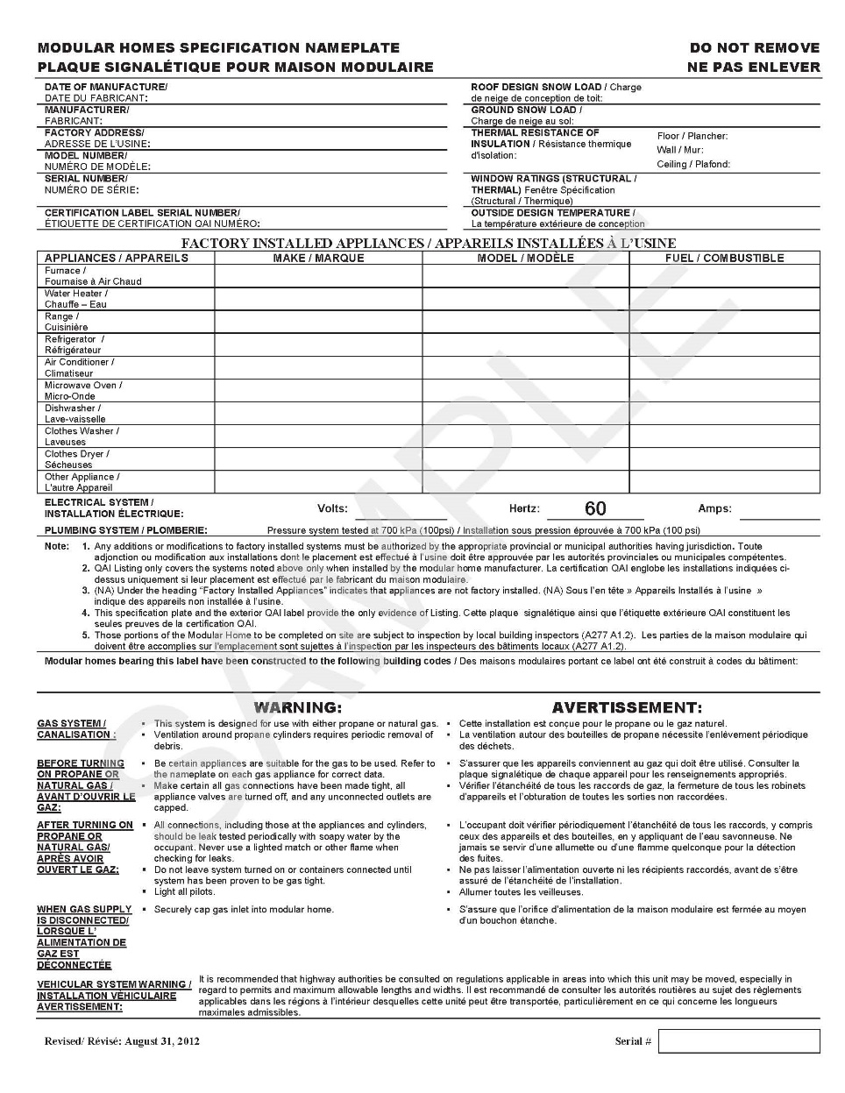
Confirming Compliance
How to Confirm Compliance
Specification sheet
6 -
Notes:
Module 6 – Confirming Compliance
How to -
The other item to check is the specification sheet.
In buildings, this is typically found adhered to the electrical panel – somewhere where it is unlikely to be removed.
For modules and panels, the sheet must be provided to the building owner and retained with the building.
The specification sheet provides the information needed to determine if the building has been designed
to address the wind, snow and earthquake loads at the installation site
to provide adequate resistance to precipitation ingress (for BC and Atlantic – is there a capillary break inboard of the cladding)
to provide the required heating capacity depending on the January design temperature
and to comply with the energy efficiency requirements for the climate zone.

Slide 25
Confirming Compliance
How to Confirm Compliance
Specification sheet
overall energy performance or - thermal resistance of insulation, and - appliance efficiencies
outside design temperature used in heat loss calculations
installed or supplied appliances (make, model, energy type)
complete electrical rating
compliance with deformation resistance test if applicable
manufacturer’s name and address
model, serial number
year of manufacture
code(s)/standards compliance
design snow load
design wind pressure
6 -
Notes:
Module 6 – Confirming Compliance
How to -
The 2016 edition of CSA A277 requires more information on the specification sheet than previously to address all of these issues.
In addition, the specification sheet will indicate if the building or module has passed the deformation resistance test provided in CSA Z240.2.1. Buildings and modules that pass this test may be installed on point-load surface-foundations even if the soil is subject to moisture movement.

Slide 26
Confirming Compliance
Applies to buildings that comply with:
the BC Building Code
CSA Z240 MH Series
6 -
Notes:
Module 6 – Confirming Compliance
Application
You will recall from Module 4 that homes that comply with CSA Z240 MH Series are exempt from the BC building Code.
The industry does not believe that this is the correct way to deal with these buildings.
Rather than being exempt, they should be deemed to comply with the applicable requirements in Part 9.
The industry expects that local authorities will inspect the label and specification sheets for these homes the same as they would for other factory-constructed buildings.

Slide 27
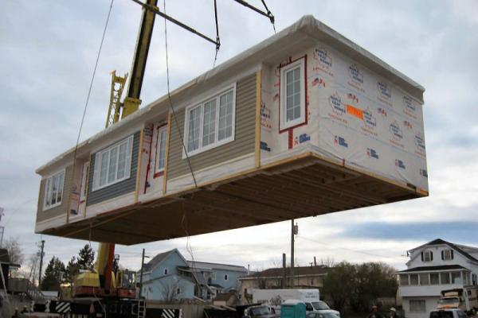
Confirming Compliance
How to Confirm Compliance
Site work
building location (e.g., spatial separation)
site preparation
foundations
installation - anchorage - stitching
service connections
other work not completed in the factory
6 -
Notes:
Module 6 – Confirming Compliance
How to -
As mentioned, all site-work is subject to the requirements of the BC Building Code.
This includes
the location of the building on the property so as to comply with requirements such as spatial separation
site preparation
foundations
Installation which includes - anchorage and - stitching modules together
service connections
and any other work not completed in the factory

Slide 28
Confirming Compliance
Non-Compliance
Non-compliance | Permit Stage | Installation Stage |  | Contact
 |  | Rectify | Reject | Retailer | Manufacturer | Certification Body
Spatial Separation | ✓ | X | X | X
6 -
Notes:
Module 6 – Confirming Compliance
Non-Compliance
The industry encourages local authorities to act if a non-compliance is identified.
The appropriate action depends on the type of non-compliance.
The table above provides a guide.
Spatial separation issues should be addressed at the permit stage.
If the building is installed on a surface foundation, it may be possible to resolve the issue with additional site preparation and repositioning of the foundation components.
If the issue cannot be resolved, the building should be rejected.
In both cases, the retailer should be advised of the problem.

Slide 29
Confirming Compliance
Non-Compliance
Non-compliance | Permit Stage | Installation Stage |  | Contact
 |  | Rectify | Reject | Retailer | Manufacturer | Certification Body
Spatial Separation | ✓ | X | X | X
Location-Specific capillary break heating capacity wind, snow, earthquake climate zone | ✓ ✓ ✓ ✓ | x x | x x X X | X X X X
6 -
Notes:
Module 6 – Confirming Compliance
Non-Compliance
Compliance of the design of the building with requirements that depend on the geographical location of the installation site can also be checked at the permitting stage.
Compliance of the constructed building should be verified on delivery.
If a capillary break is required but not provided, it may be possible to remove and re-install the cladding.
Similarly, if the heating system is sized based on an incorrect 2.5% January mean design temperature, It may be possible to replace the appliance.
In both these cases, however, those aspects of the building would no longer be covered by the certification.
If the building does not comply with the requirements related to climate or seismic loads, it should be rejected.
In all of these cases, the retailer should be advised of the non-compliances.

Slide 30
Confirming Compliance
Non-Compliance
Non-compliance | Permit Stage | Installation Stage |  | Contact
 |  | Rectify | Reject | Retailer | Manufacturer | Certification Body
Spatial Separation | ✓ | X | X | X
Location-Specific capillary break heating capacity wind, snow, earthquake climate zone | ✓ ✓ ✓ ✓ | x x | x x X X | X X X X
Factory-Work minor significant health or safety |  | x X | X |  | X X | If repeated X
6 -
Notes:
Module 6 – Confirming Compliance
Non-Compliance
There have been instances where a local official has identified a non-compliance in work completed in the factory.
If the non-compliance is minor and will not create a health or safety hazard, the manufacturer should be advised. If the non-compliance is identified in more than one instance in buildings from the same manufacturer, the certification body should be notified.
If the non-compliance is likely to create a significant health or safety hazard, - it should be rectified on site, or - the building should be rejected. Where the non-compliance is resolved on site or not, the certification body should be notified.

