Slide 1
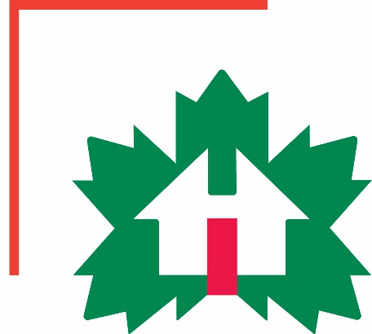
Factory-Built Housing in Canada – Evolution, Regulatory Requirements and Confirmation of Compliance
Module 5: Facilitating Compliance with factory-built home
Prepared for Municipal Officials in British Columbia August 2017

Slide 2
Modules
Who We Are – CHBA-MOD and MHABC
Factory-Built Housing - Then and Now
The Industry
Applicable Technical Requirements
Facilitating Compliance
Confirming Compliance
Challenges
Take-Aways
5 -
Notes:
Module 5 – Facilitating Compliance
There are a significant advantages to constructing buildings in factories.
Many of these relate to cost, scheduling, safety and quality of the product.
Factory-building also makes it easier to comply with the applicable technical requirements.
Module 5 describes how factory-building facilitates compliance.

Slide 3
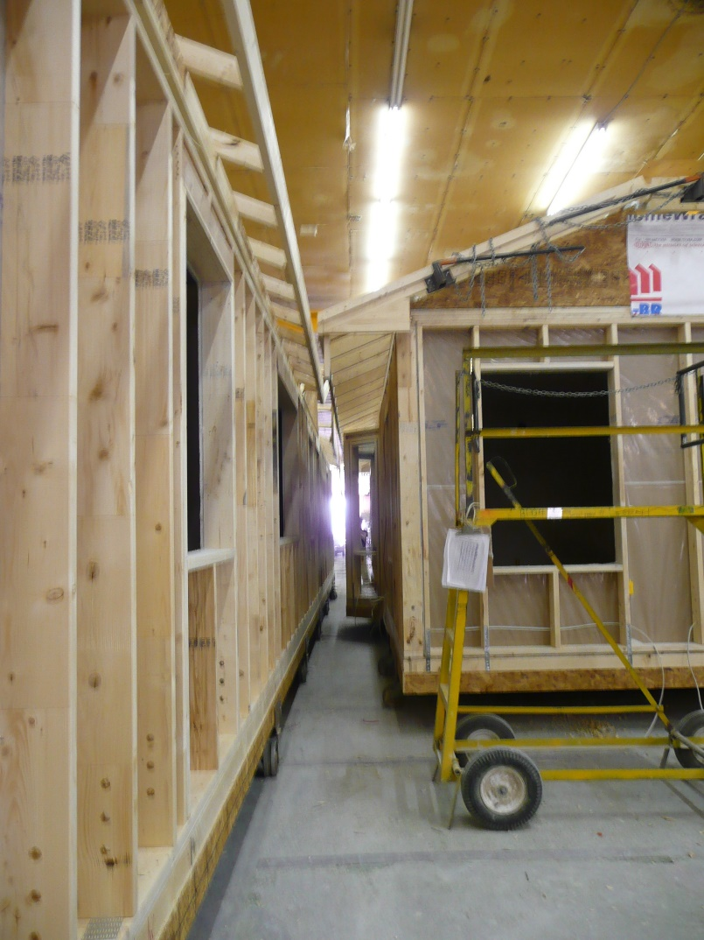
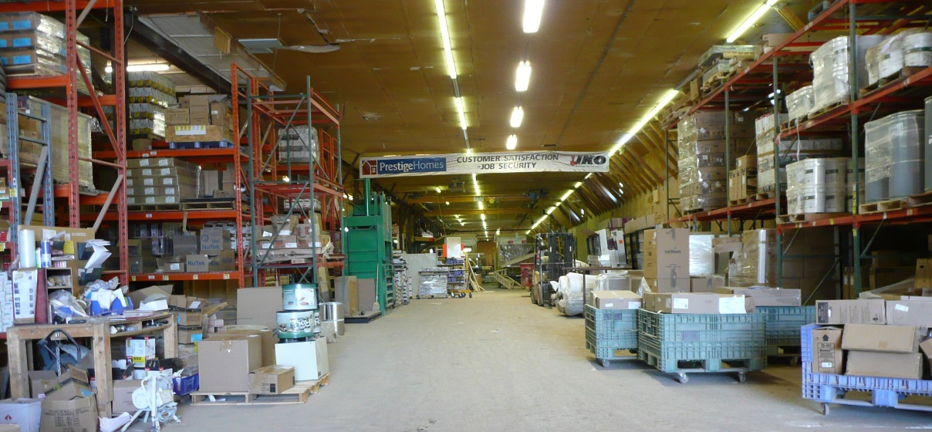
Facilitating Compliance
Controlled Conditions
all materials and components, processes and products protected
no built-in moisture
Prestige Homes, NB
Prestige Homes, NB
5 -
Notes:
Module 5 – Facilitating Compliance
Controlled Conditions
Building in a factory means that
all materials and components, processes and products are protected from the weather
there is no built-in moisture so complying with the maximum 19% moisture content for lumber is not an issue.
….

Slide 4
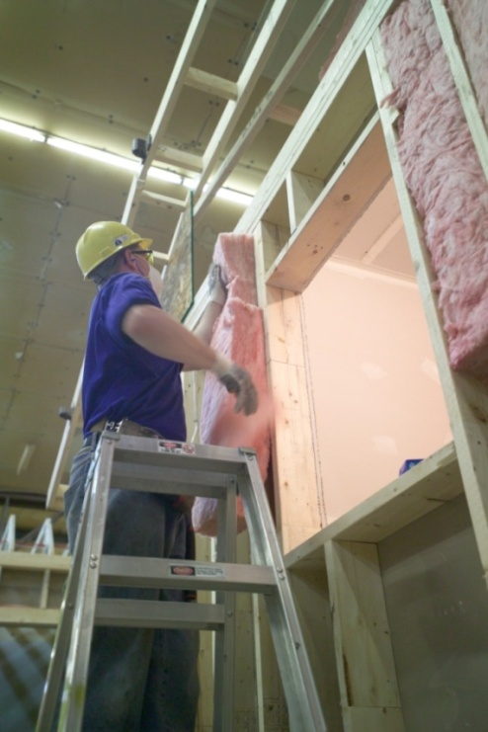
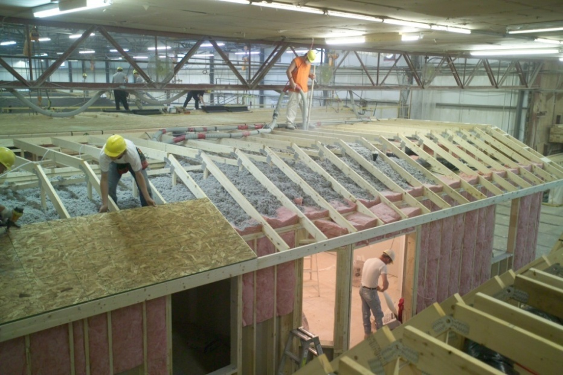
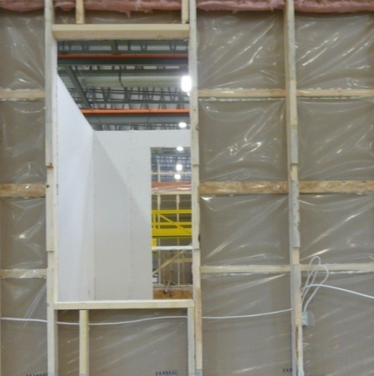
Facilitating Compliance
Controlled Conditions
inside-out construction
integrity of air and vapour barriers
greater airtightness
minimize likelihood of moisture damage in the building envelope
better energy efficiency
5 -
Notes:
Module 5 – Facilitating Compliance
Controlled Conditions
With protection from the elements, there is no pressure to get the building closed in.
The buildings can be constructed inside out – which makes it easier to maintain the integrity of critical elements like the air barrier system,
providing greater airtightness.
This in turn
minimizes the probability of moisture damage in the building envelope
and
has a significant impact on energy efficiency

Slide 5
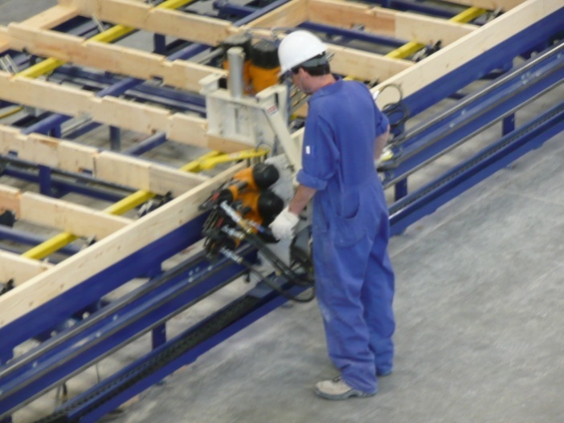
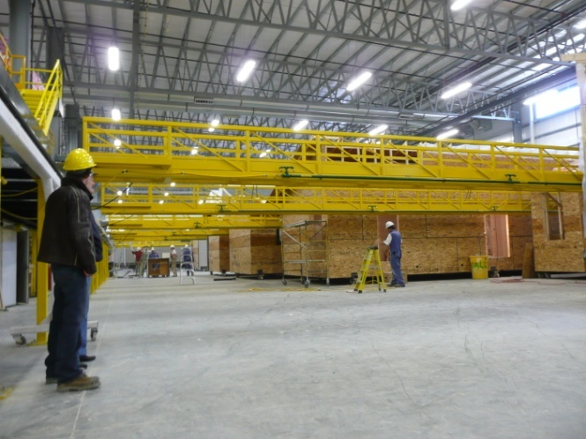
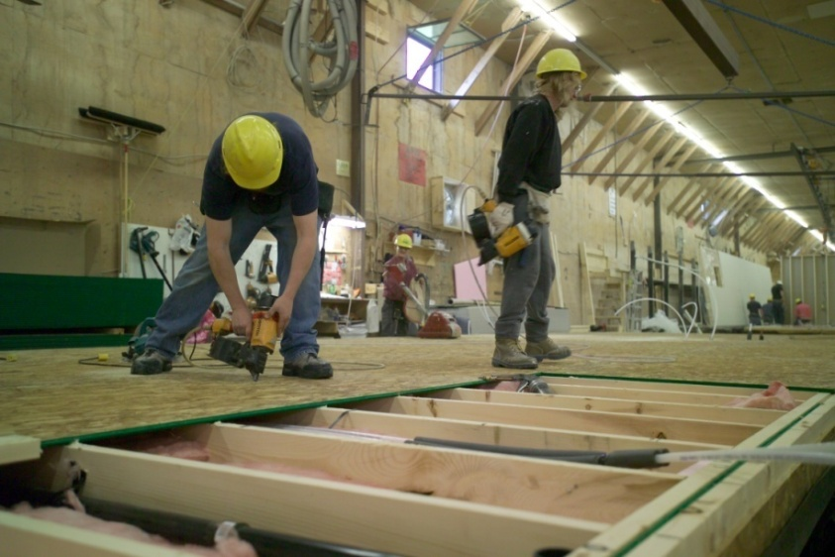
Facilitating Compliance
Factory Process
building moves, not workers or tools
better working conditions
attention to detail
Maple Leaf Homes, NB
Triple M Housing AB
5 -
Notes:
Module 5 – Facilitating Compliance
Factory-process
Factories may be more or less automated.
In any case, the building moves rather than the workers and their tools.
That combined with the controlled environment provides:
better working conditions
and greater attention to detail.

Slide 6
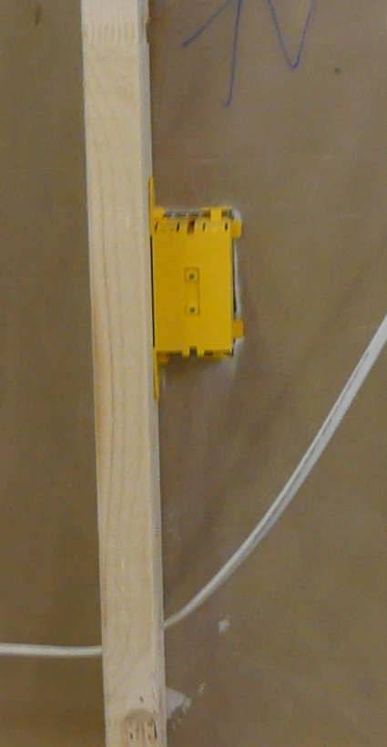
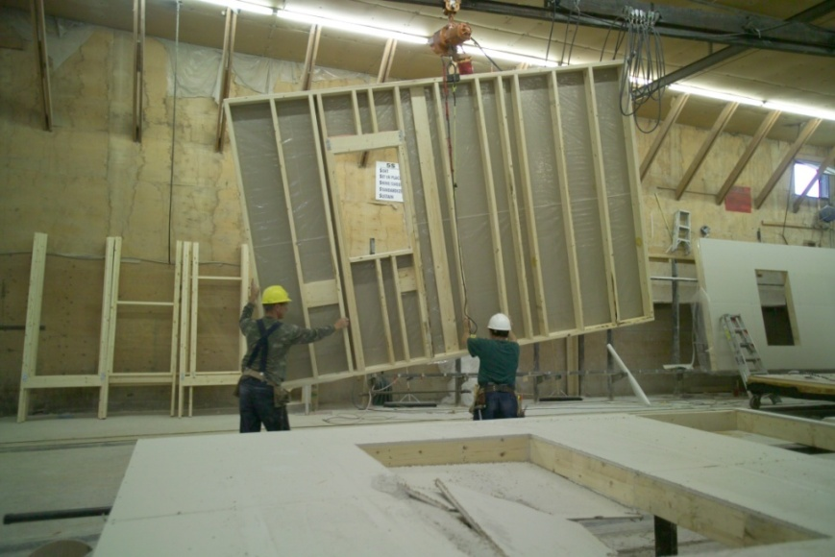
Facilitating Compliance
In-House Trades
consistency of training
integrity of completed work
5 -
Notes:
Module 5 – Facilitating Compliance
In-House Trades
Building in a factory means that all trades-people are in-house.
Not only do they have the training to do their own individual tasks, they are trained to appreciate how the work of others is critical to
maintaining the integrity of all the building assemblies and systems
and the overall performance of the final product.
Problems of one trade damaging the work of another is avoided.

Slide 7
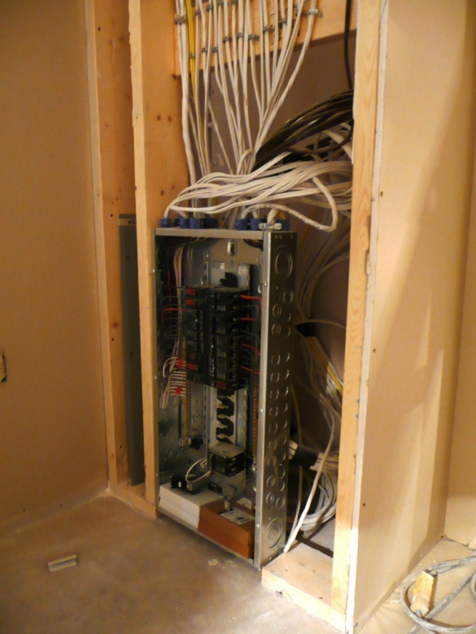
Facilitating Compliance
In-House Trades
as much work as possible is completed in the factory
5 -
Notes:
Module 5 – Facilitating Compliance
In-House Trades
As much work as possible is completed in the factory to maintain a high level of quality and compliance.
This is a photo of a completely wired electrical panel for a building that is to be placed on a basement foundation.
Once the superstructure is installed, the panel is dropped down into the basement and this wall will be dry-walled.

Slide 8
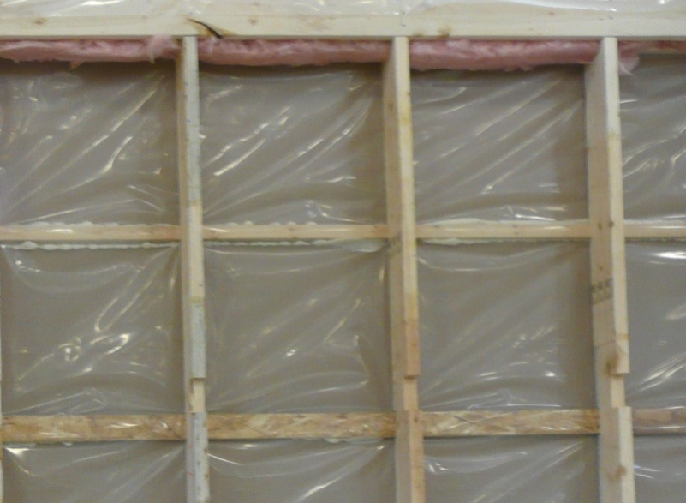
Facilitating Compliance
Transportation and Installation Considerations
strength and rigidity beyond Code
5 -
Notes:
Module 5 – Facilitating Compliance
Transportation and Installation Considerations
Factory-constructed buildings have to be stronger and stiffer than site-constructed buildings to resist the loads imposed during transit and installation.
To comply with the lateral load resistance requirements that were included in the 2012 BCBC and the moderate wind loads and high earthquake loads in BC, factory-constructed buildings needed few, if any, upgrades to structural components, depending on the particular building design.
Changes to the earthquake resistance requirements for the next edition of the BCBC will again have limited if any impact on factory-construction.

Slide 9
Facilitating Compliance
Third-Party Audits and Inspections
(see Module 6)
5 -
Notes:
Module 5 – Facilitating Compliance
Third-Party Audits and Inspections
The certification process itself includes steps that are not typically done with site construction and further improve the likelihood of compliance.
These are discussed in Module 6.

