Slide 1
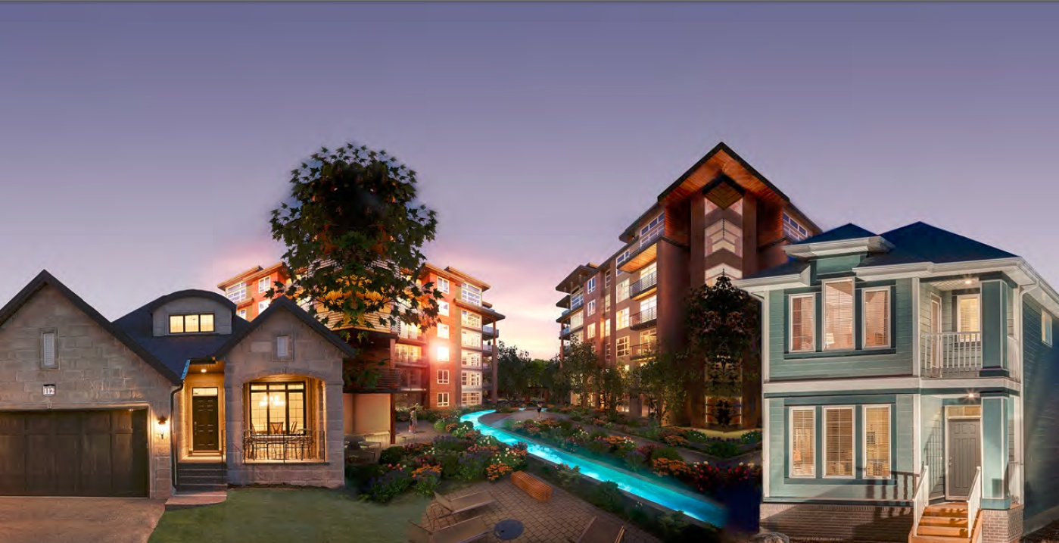
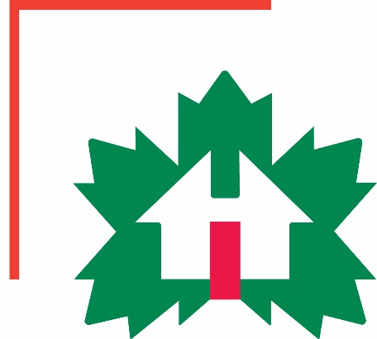
Factory-Built Housing in Canada – Evolution, Regulatory Requirements and Confirmation of Compliance
Module 2: Prefabricated Buildings – Then and Now
Prepared for Municipal Officials in British Columbia August 2017

Slide 2
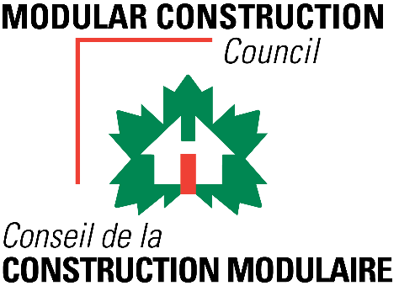
Modules
Who We Are – CHBA-MOD and MHABC
Factory-Built Housing - Then and Now
The Industry
Applicable Technical Requirements
Facilitating Compliance
Confirming Compliance
Challenges
Take-Aways
2 -
Notes:
Module 2.1 - Outline
Factory building in Canada has come a long way.
This module provides a short overview.

Slide 3
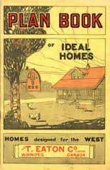
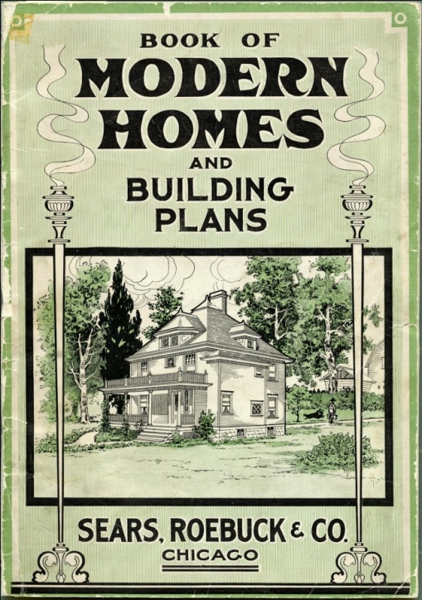
Factory-Built Housing - Then
Residential
kits
www.historymuseum.ca
2 -
Notes:
Module 2.1 – Prefab Buildings - Then
Prefab History –Kits
Our prefabricated buildings evolved from:
kit houses such as those sold by the T. Eaton Company, and Sears and Roebuck until the depression …

Slide 4
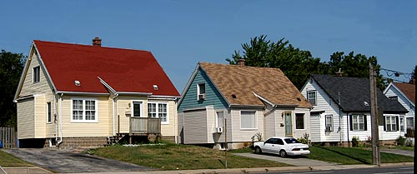
Factory-Built Housing - Then
Residential
panelized
Victory Homes, Hamilton
2 -
Notes:
Module 2.1 – Prefab Buildings - Then
Prefab History – Panelized
….
panelized houses that were built across the country during the Second World War,
…

Slide 5
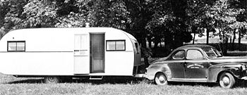
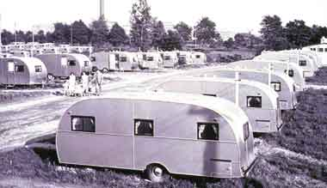
Factory-Built Housing - Then
Residential
mobile
2 -
Notes:
Module 2.1 – Prefab Buildings - Then
Prefab History – Trailers
…
and travel trailers that were used for - camping and travel vacations, - and housing for itinerant and factory workers.
….

Slide 6
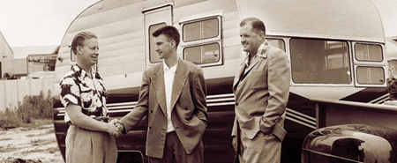
Factory-Built Housing - Then
Residential
mobile
AlbertaTrailer Hire, 1947. ATCO http://www.atcosl.com/en-ca/About-Us/
2 -
Notes:
Module 2.1 – Prefab Buildings - Then
Prefab History – Trailers
…
such as those built by Alberta Trailer Hire, the predecessor to ATCO, which was founded in 1947.

Slide 7
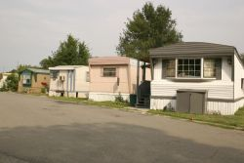
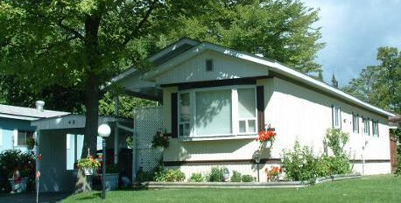
Factory-Built Housing - Then
Residential
mobile
Trailer Park, Sudbury
Georgian Glen, ON
2 -
Notes:
Module 2.1 – Prefab Buildings - Then
Prefab History – Residential - Mobile
The trailers were followed by mobile homes.

Slide 8
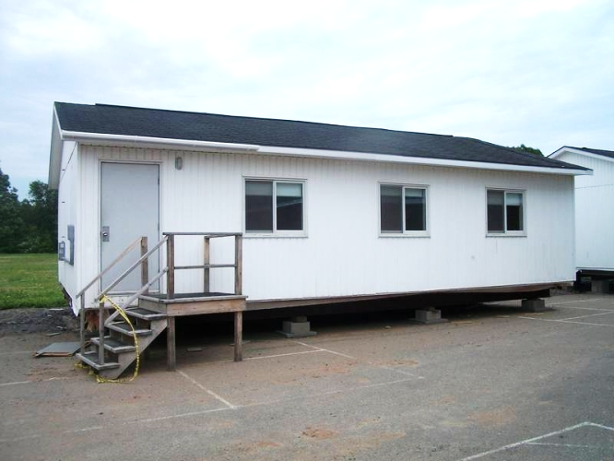
Factory Built Housing - Then
Non-Residential
portable classrooms
site offices
www.estatesincanada
Site Lab, 1984. www.lumcon.edu
2 -
Notes:
Module 2.1 – Prefab Buildings - Then
Prefab History – Non-Residential
On the non-residential side, early prefabricated buildings were primarily
temporary classrooms
and site offices

Slide 9
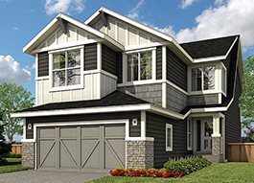
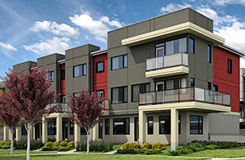
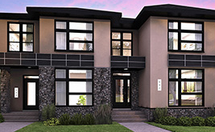
Factory-Built Housing - Now
Residential
panelized
“Harmony”, Cochrane AB, ACQBUILT
“Equa”, Edmonton, ACQBUILT
“Oxford”, Edmonton, ACQBUILT
2 -
Notes:
Module 2.1 – Prefab Buildings - Now
Residential - Panelized
ACQBUILT (pronounced ak-”Q”-bilt) is one of, if not the,
largest builder of panelized homes in Canada today.
These are a few images of single-family and multi-unit residential buildings from their website.

Slide 10
Factory-Built Housing - Now
Residential
modular
2 -
Notes:
Module 2.1 – Prefab Buildings - Now
Residential - Modular
Most prefabricated residential buildings are modular,
constructed as boxes that are assembled on site.
Just like site-built, they can be any form….

Slide 11
Factory-Built Housing - Now
Residential
modular
Linden, Kent Homes, NB
2 -
Notes:
Module 2.1 – Prefab Buildings - Now
Residential - Modular
From simple 1-storey single family …

Slide 12
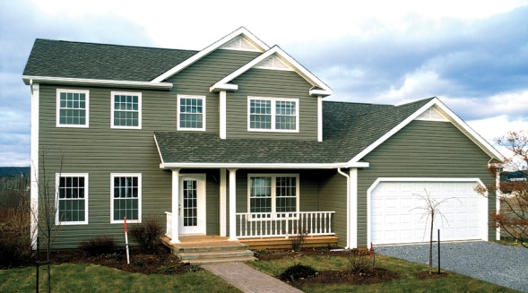
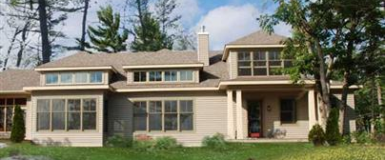
Factory-Built Housing - Now
Residential
modular
Linden, Kent Homes, NB
Exelsa, Profab, QC
Starr Cottage, Royal Homes, ON
2 -
Notes:
Module 2.1 – Prefab Buildings - Now
Residential - Modular
To simple or more elaborate 2-storey single family homes ,
in traditional or more contemporary styles.

Slide 13
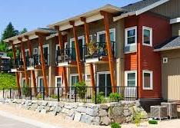
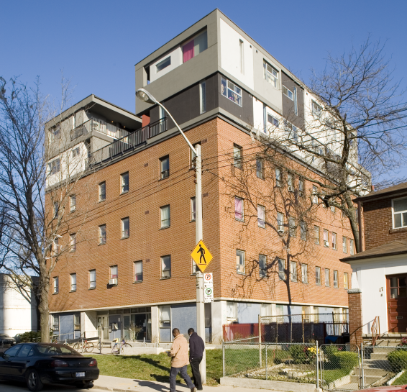
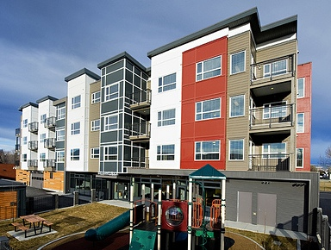
Factory-Built Housing - Now
Residential
Modular – multi-unit
BC Housing, Olympic Legacy Enderly and Surrey
St. Clare’s Multifaith Housing Society, Toronto, LGA Architectural Partners.
Grandeur Housing and Innovative Residential Rent-to-own, Saskatoon
BC Housing, Tutt Street Place, Kelowna
2 -
Notes:
Module 2.1 – Prefab Buildings - Now
Residential - Modular
The industry also builds modular multi-unit residential – single and multi storey
– new and retrofit
...

Slide 14
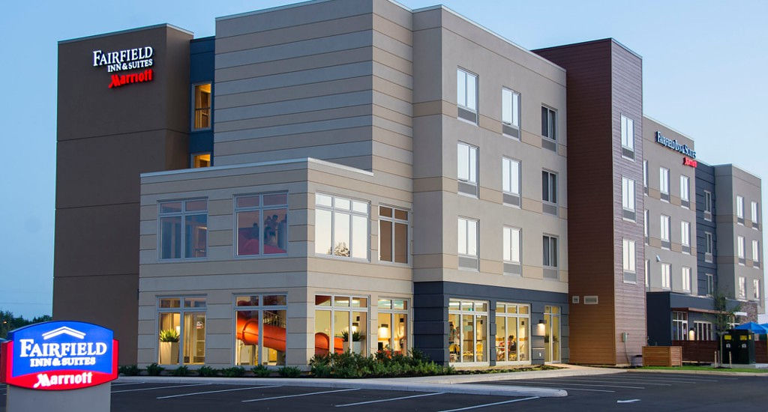
Factory-Built Housing - Now
Residential with Other Occupancies
modular
Prefab Hotel Floors 2-4, Fairfield Marriott, Moncton, Supreme Homes
2 -
Notes:
Module 2.1 – Prefab Buildings - Now
Residential and other Occupancies - Modular
… and hotels

Slide 15
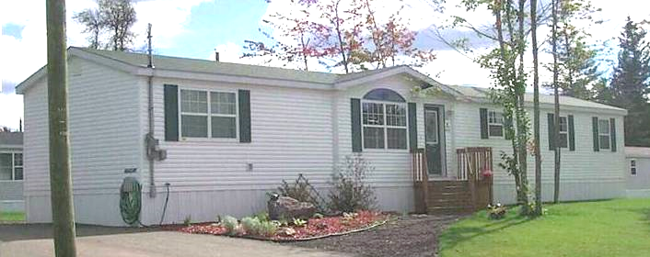
Factory-Built Housing - Now
Residential
modular - manufactured
Kent Homes, NB
Moduline,BC
2 -
Notes:
Module 2.2 – Prefab Buildings - Now
Residential – Modular – Manufactured
Manufactured homes, which may or may not look similar to older mobile homes,
are a type of modular home
These are described in more detail in the context of the technical requirements in Module 4.

Slide 16
Factory-Built Housing - Now
Non-Residential
2 -
Notes:
Module 2.1 – Prefab Buildings - Now
Non-Residential
Many kinds of non-residential buildings are constructed –
…

Slide 17
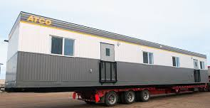
Factory-Built Housing - Now
Non-Residential
2 -
Notes:
Module 2.1 – Prefab Buildings - Now
Non-Residential
…
site offices
…

Slide 18
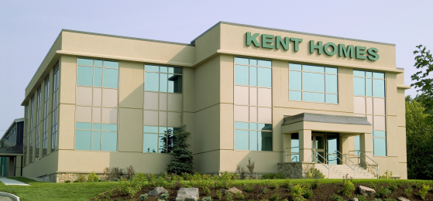
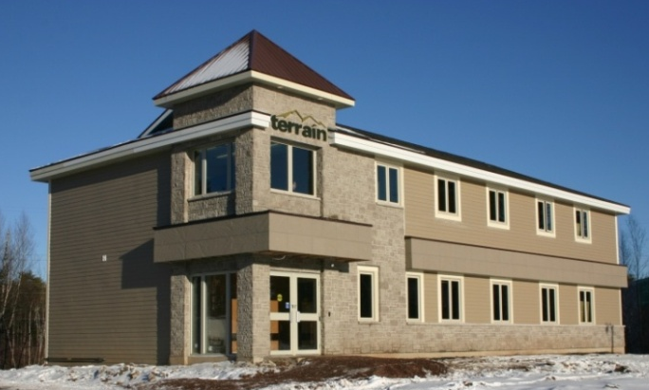
Factory-Built Housing - Now
Non-Residential
2 -
Notes:
Module 2.1 – Prefab Buildings - Now
Non-Residential
…
office buildings
…

Slide 19
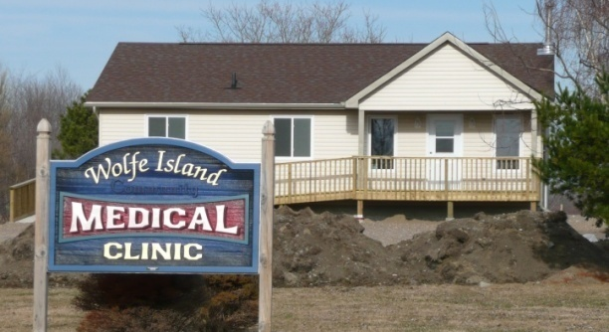
Factory-Built Housing - Now
Non-Residential
Guidcrest Homes, ON
2 -
Notes:
Module 2.1 – Prefab Buildings - Now
Non-Residential
…
Medical clinics
…

Slide 20
Factory-Built Housing - Now
Non-Residential
Guidcrest Homes, ON
Kent Homes, NB
2 -
Notes:
Module 2.1 – Prefab Buildings - Now
Non-Residential
…
and work camps, to illustrate a few.

Slide 21
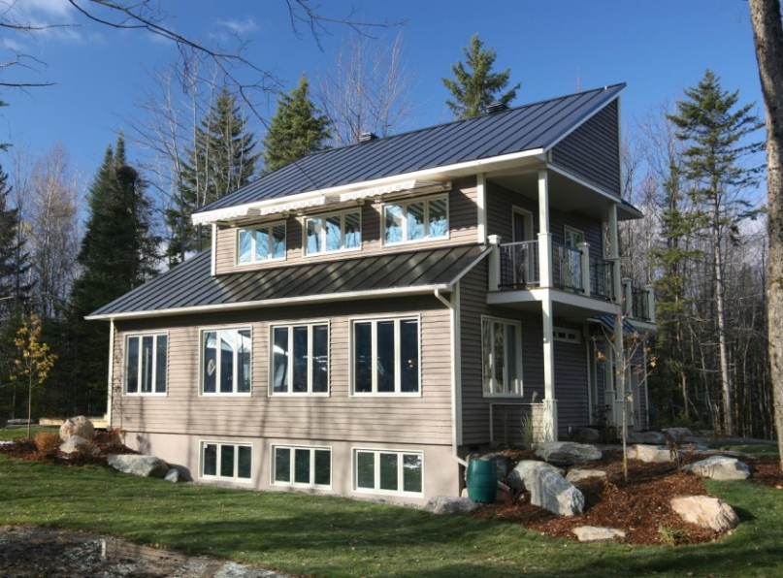
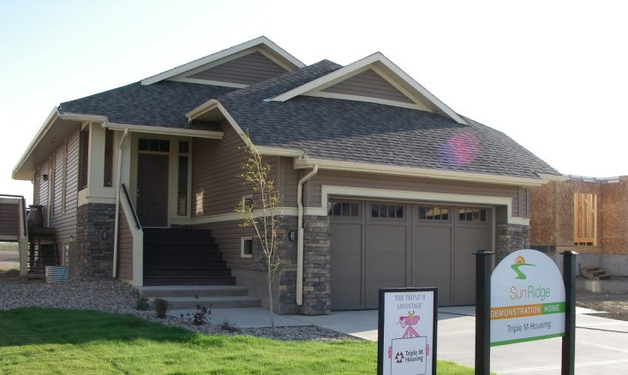
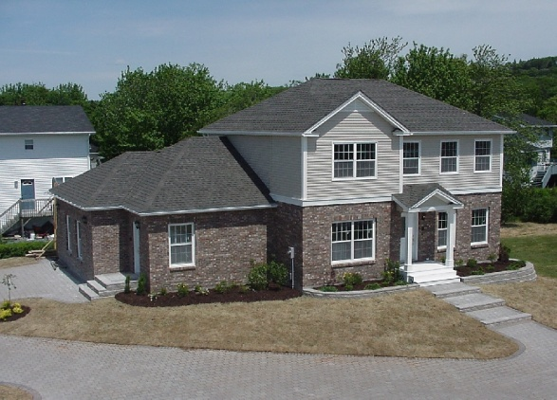
Factory-Built Housing – Now Energy Efficiency and Sustainability
Leading Edge
Canada’s first EnviroHome®
Canada’s first entirely BuiltGreen® community
Canada’s first CMHC EQuilibrium™ initiative demonstration home
EcoTerra™ Home, Alouette Homes, QC
BuiltGreen® Home, Triple M Housing, AB
EnviroHome®, Prestige Homes, NB
2 -
Notes:
Module 2.1 – Prefab Buildings - Now
Energy Efficiency & Sustainability
Factory-builders have long been leaders in energy efficiency and sustainability.
Canada’s first EnviroHome® was prefabricated
The homes in Canada’s first entirely BuiltGreen® community were prefabricated
Canada’s first CMHC EQuilibrium™ initiative demonstration home was prefabricated

Slide 22
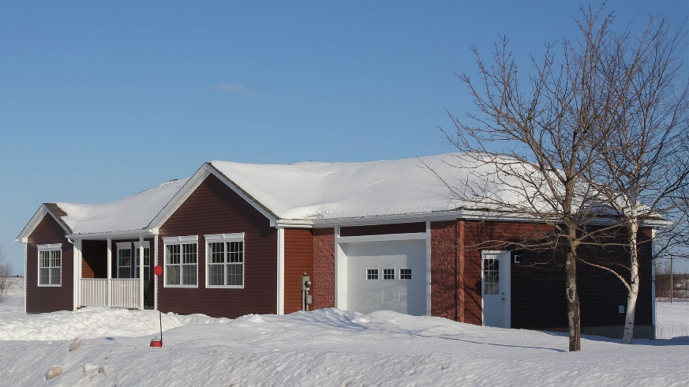
Factory-Built Housing – Now Energy Efficiency and Sustainability
Awards
2012 Energuide Rating Service – Most Energy Efficient House, Bathurst, NB
2012 Energy Efficient Community Award, North America’s first EcoPlus net-zero townhouse community, Fredericton, NB
Photos: CNW Group/Maple Leaf Homes, New Brunswick
2 -
Notes:
Module 2.1 – Prefab Buildings - Now
Energy Efficiency & Sustainability
….
The 2012 Energuide Most Energy Efficient House was a prefabricated home
and
in the same year, North America’s first EcoPlus net-zero townhouse community was a row of prefabricated townhouses

Slide 23
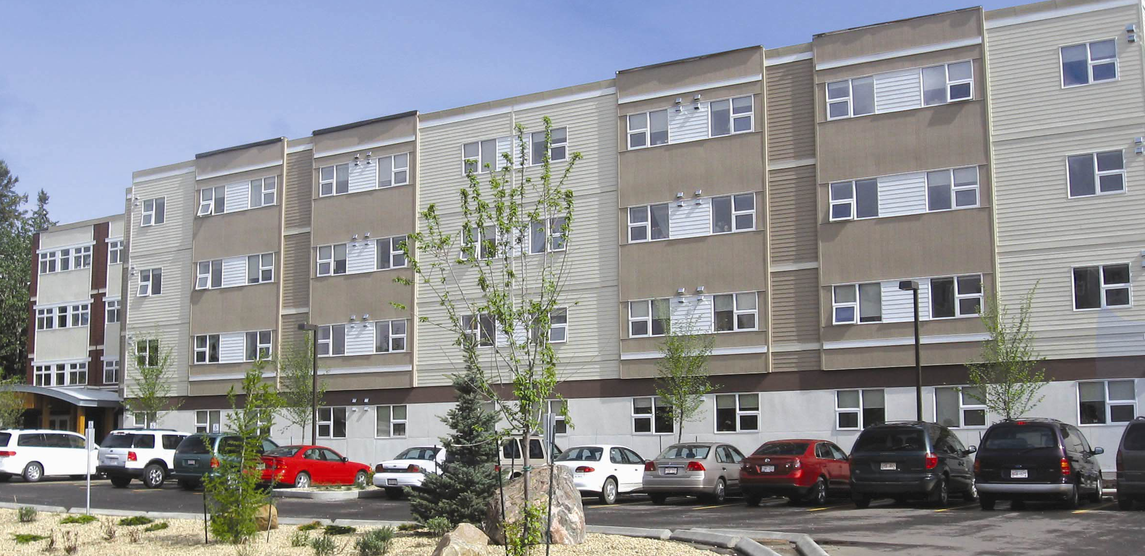
Factory-Built Housing – Now Energy Efficiency and Sustainability
CO₂ Emissions Reduction
significant reductions compared to on-site construction considering:
material deliveries
crew travel
equipment usage
winter heating
43% reduction in CO₂ emissions during construction: North Ridge Place Seniors Affordable Housing Project, St. Albert, AB
University of Alberta Study (Photo: Rose Country Advertising and Public Relations)
2 -
Notes:
Module 2.1 – Prefab Buildings - Now
Energy Efficiency & Sustainability
Prefabrication of buildings has also been found to result in notable lower CO₂ emissions.
Considering:
material deliveries
crew travel
equipment usage, and
winter heating
a study of one multi-unit residential building found a 43% reduction in CO₂ emissions during construction compared to site-built.

