Slide 1
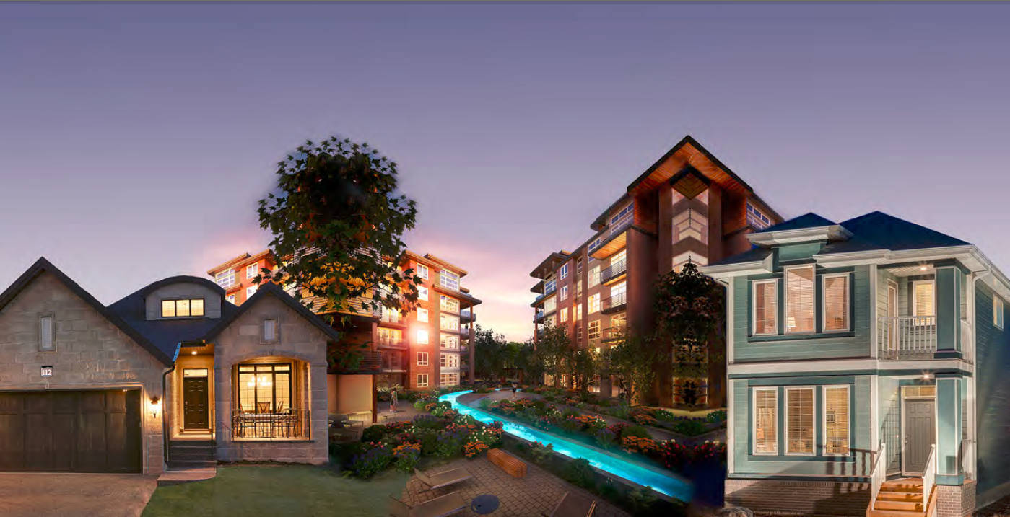
Factory-Built Housing in Canada – Evolution, Regulatory Requirements and Confirmation of Compliance
Module 8:Take-Aways
Prepared for Municipal Officials in British Columbia August 2017

Slide 2
Modules
Who We Are – CHBA-MOD and MHABC
Factory-Built Housing - Then and Now
The Industry
Applicable Technical Requirements
Facilitating Compliance
Confirming Compliance
Challenges
Take-Aways
8 -
Notes:
Module 8 - Take-Aways
This presentation has covered a lot of material.
There are 12 main take-aways.

Slide 3
Take-Aways
Prefabricated buildings have come a long way.
____ % of single family homes are prefabricated
factory-builders are among Canada’s leaders in energy efficiency and sustainability
All site work must comply with the BCBC.
In-factory work must comply with
the BCBC
OR
b) CSA Z240 MH Series Manufactured Homes.
The only significant difference between BCBC-compliant homes and CSA Z240 MH Series homes is somewhat less energy efficiency.
Foundations and anchorage complying with CSA Z240.10.1 Site Preparation, Foundation and Anchorage of Buildings comply with the BCBC
Compliance
8 -
Notes:
Module 8 – Take-Aways
Subjects

Slide 4
Take-Aways
Certification has long been accepted as a means for confirming acceptability of building products – certification of buildings, modules and panels in accordance with CSA A277 Procedure for certification of Prefabricated Buildings, Modules and Panels is no different
In-factory quality control is notably better than on-site
The local authority should confirm certification and compliance with location-specific requirements – check labels and specification sheets
The local authority can reject non-compliant products, whether they are designed to the BCBC or CSA Z240 MH Series Manufactured Homes
Certification & Confirming Compliance
8 -
Notes:
Module 8 – Take-Aways
Subjects

Slide 5
Take-Aways
There is no basis for land-use by-laws to discriminate against prefabricated buildings – zoning rules can differentiate based on architectural features but not on where the building is constructed
Park model trailers are not designed or constructed to be used year-round; this should be recognized in land-use by-laws
Energy efficiency for prefabricated buildings is a challenge especially where there are stringent transportation regulations or challenging geography
Challenges
8 -
Notes:
Module 8 – Take-Aways
Subjects

Slide 6
Take-Aways
For more information, contact
Gord Rattray, Executive Director
PO Box 31661, Pitt Meadows, BC V3Y 2H1
Phone: 604-466-2006
Fax: 604-466-3006
E-mail: gord@mhabc.com
8 -
Notes:
Module 8 – Take-Aways
Subjects

