Slide 1
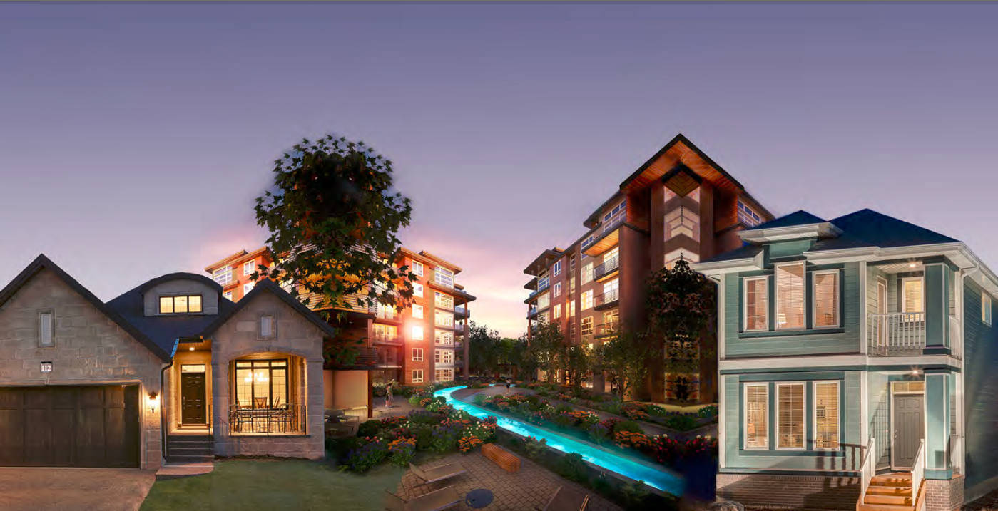
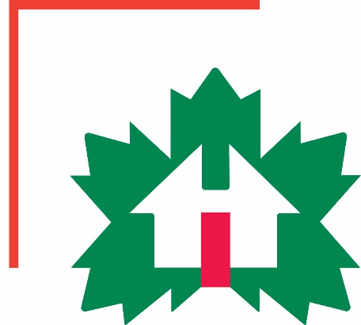
Factory-Built Housing in Canada – Evolution, Regulatory Requirements and Confirmation of Compliance
Module 1: Who We Are – CHBA-MOD and MHABC
Prepared for Municipal Officials in British Columbia August 2017

Slide 2
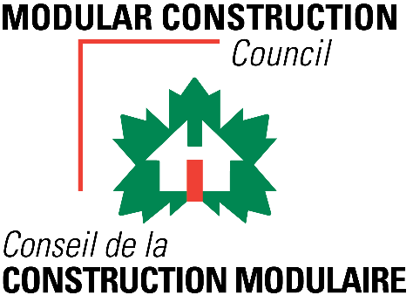
Modules
Who we are – CHBA-MOD and MHABC
Factory-Built Housing - Then and Now
The Industry
Applicable Technical Requirements
Facilitating Compliance
Confirming Compliance
Challenges
Take-Aways
1 -
Notes:
Module 1 - Outline
This module provides a introduction to the authors:
the Modular Construction Council of the Canadian Home Builders’ Association
and
the Manufactured Housing Association of BC

Slide 3
Who We Are – CHBA-MOD and MHABC
Modular Construction Council (CHBA-MOD)
successor to the Canadian Manufactured Housing Institute
a council of the Canadian Home Builders’ Association
Canada’s national organization for factory-built housing
members:
from all regions of Canada, and from the U.S.
from all facets of the industry: e.g. builders, developers, suppliers, warranty
representing all types of construction: - residential - institutional - commercial - industrial
1 -
Notes:
Module 1 – CHBA-MOD – Who We Are
The Canadian Manufactured Housing Institute was established in 1953 as Canada’s national organization for prefabricated building.
It was dissolved at the end of 2016 to reinvent itself as the Modular Construction Council of the Canadian Home Builders’ association
The Council continues the Institute’s role as Canada’s national organization for prefabricated building with
members:
from all regions of Canada, and from the U.S.
from all facets of the industry
representing all types of construction - residential, institutional, commercial, and industrial

Slide 4
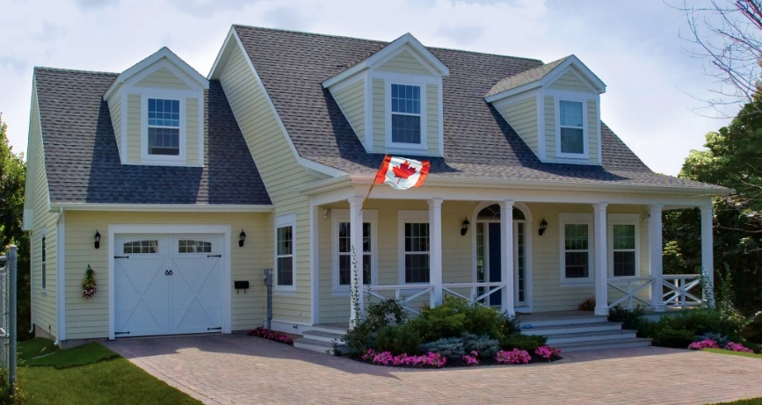
Who We Are – CHBA-MOD and MHABC
Modular Construction Council (CHBA-MOD)
Key Priorities
codes and standards development
building awareness of the benefits of prefabricated construction among industry, governments and consumers
1 -
Notes:
Module 1 –MCC – Priorities
Much of the Modular Construction Council’s work focuses on development and maintenance of building codes and standards.
Building technology and practice is changing constantly and codes and standards have to keep up.
Assisted by CHBA staff from the Technical Research Committee, staff of Modular Construction Council work to ensure that requirements do not unfairly discriminate against prefabricated buildings.
The Council also works hard to build awareness among industry, governments and consumers of the benefits of prefabricated construction.

Slide 5
Who We Are – CHBA-MOD and MHABC
Manufactured Housing Association of British Columbia (MHABC)
The Purpose of the Manufactured Housing Association of BC is to work for the betterment, greater acceptance and expansion of manufactured and modular residential housing in British Columbia through ensuring a fair and competitive environment for industry participants while providing safe and cost effective housing options for the citizens of this province”
1 -
Notes:
Module 1 – MHABC

